Slide 1

Library software for Andaman College
Batch : MP-IT1
SIH : DS165
Guide : K.Lakshminarayana
Team Members: Pinnapureddy Dileep(177Y1A1209),
L.Madhumathi(177Y1A1221)

Slide 2
Abstract
Library software for Andaman College system is a project which aims in developing a computerized system to maintain all the daily work of library .This project has many features which are generally not available in normal library management systems like automatic categorization of books . It also has a facility of admin login through which the admin can monitor the whole system . It has also a facility where student after logging in their accounts can see list of books issued and its issue date and return date and also the students can request the librarian to add new books by filling the book request form . The librarian after logging into his account i.e. admin account can generate various reports such as student report , issue report, teacher report and book report.

Slide 3
Introduction
Library software is one of the most important factor in educational institution. It is necessary for students to check the books and useful content from the computerized software.
Library software for Andaman college specifies the use of computerized library which facilitates the search of book based on title , author.
Books and student maintenance modules are also included in this system which would keep track of the students using the library and also a detailed description about the books a library contains. With this computerized system there will be no loss of book record or member record which generally happens when a non computerized system is used.

Slide 4
Objective
The aim of this project is to develop a system which maintains Library software for Andaman college students.
We developed an computerization of Library Activities and Book Transactions.
We design a system for library management system for Andaman college that has automatic categorization of books in genres based on title.
The developed system is used to search from the internet and get information about the book and put them into appropriate category based on title, authors and information collected online.

Slide 5
System Specification
Hardware Requirement
RAM 2GB
Processor: Intel i3
Hard Drive : 512 GB
Software Requirement
MySQL
HTML,PHP,JavaScript
Node JS
OS Windows Server 2003/2007 etc.

Slide 6
Modules
For Library Management System it is divided into the following Modules:
Admin Module
Student Module
Teacher Module
Book Module
Book Transaction Module
Report Module

Slide 7
EXISTING VS PROPOSED SYSTEM
Existing system does not have a facility of online reservation of books whereas proposed system has a facility of online reservation of books.
Existing system does not have any facility to generate student reports as well book issue reports whereas proposed system provides librarian with a tool to generate reports.
Existing system does not has any facility for book request and suggestions where as in proposed system after logging in to their accounts student can request books as well as provide suggestions to improve library.
Existing system does not have a facility of voice based search of books where as proposed system has a facility of voice based search.

Slide 8
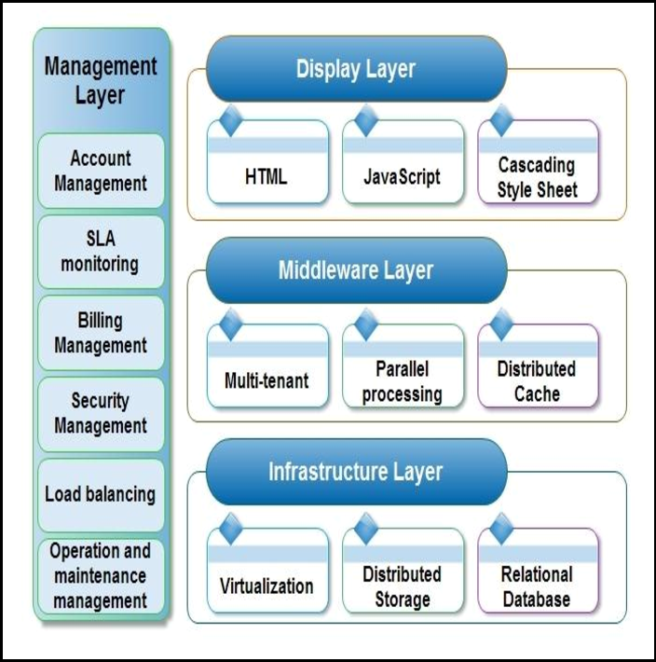
System Architecture

Slide 9
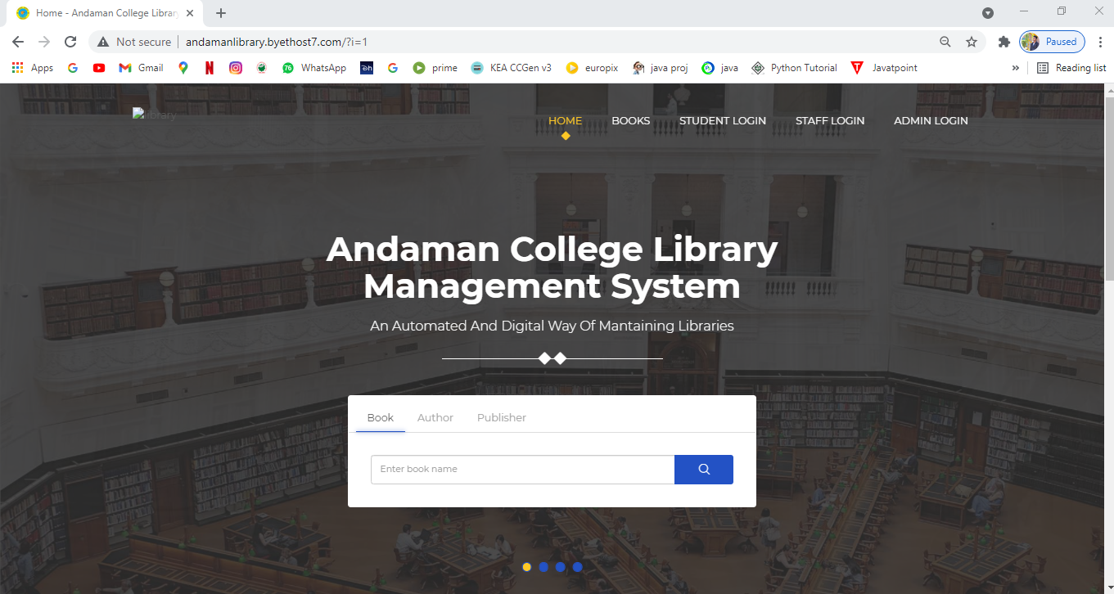
Home page of Andaman College Library

Slide 10
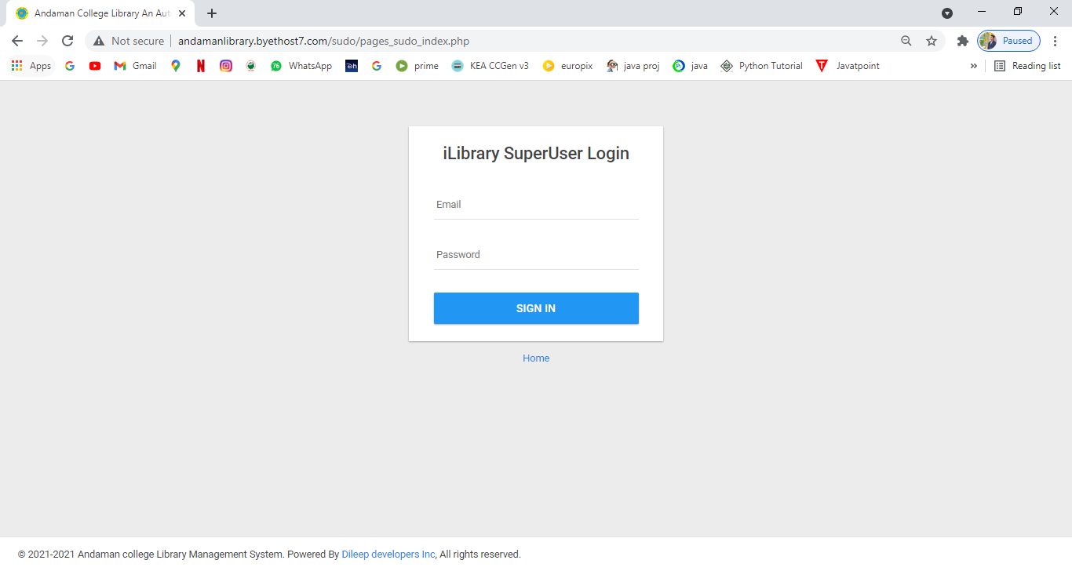
Admin Login Page

Slide 11
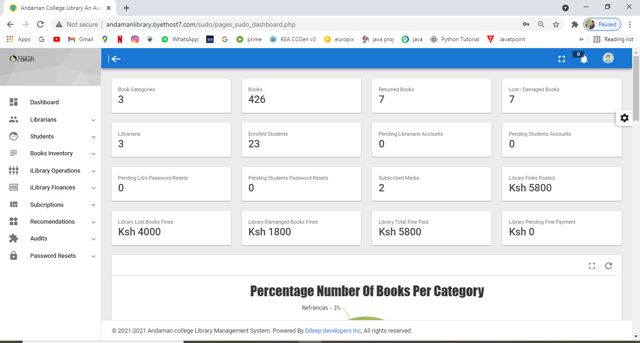
Admin dashboard

Slide 12
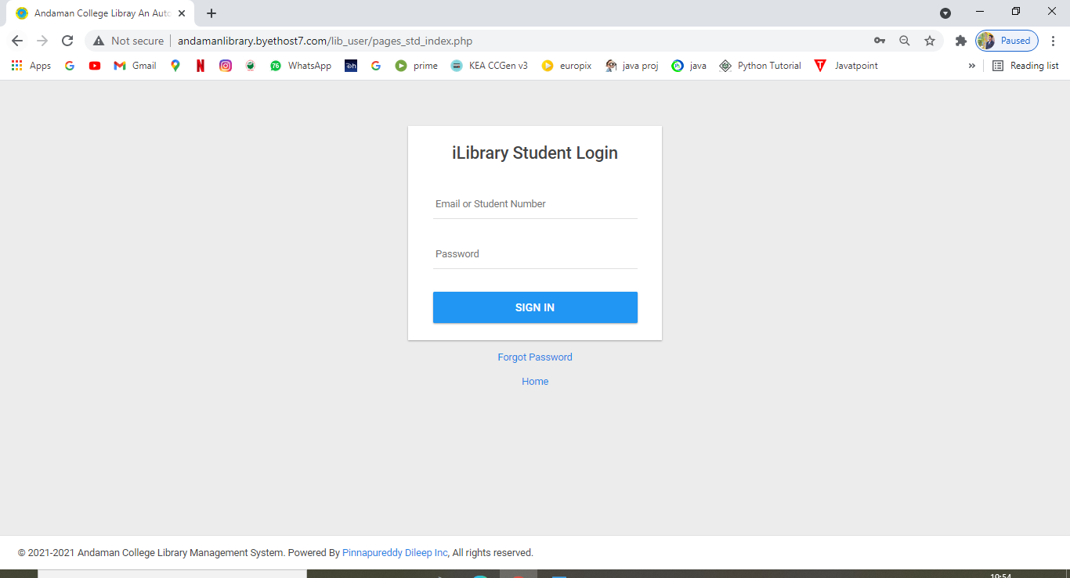
Student Login Page

Slide 13
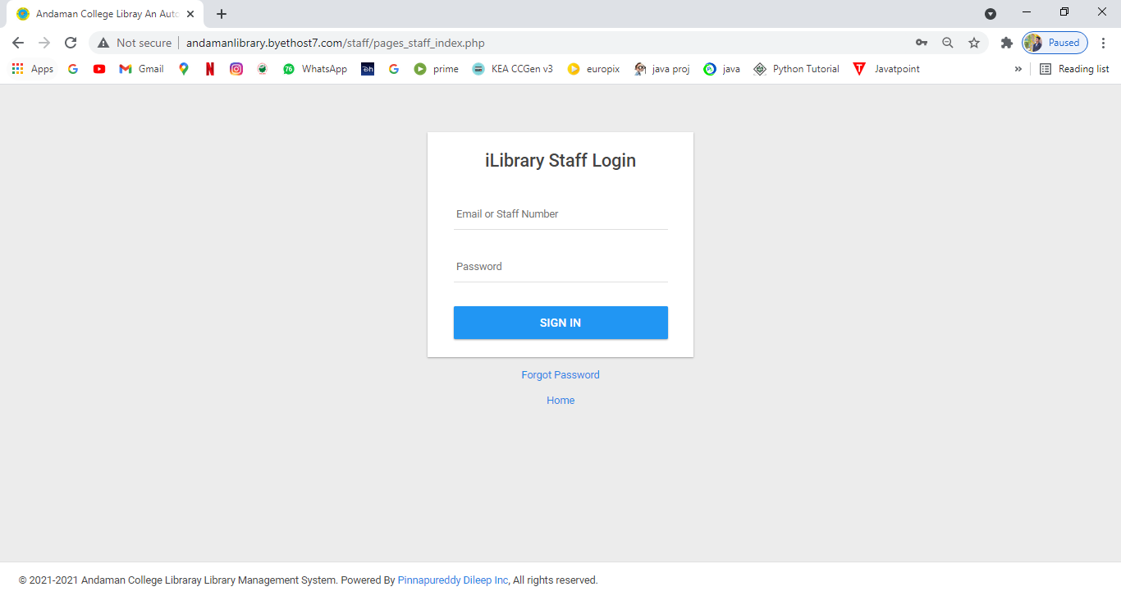
Staff Login Page

Slide 14
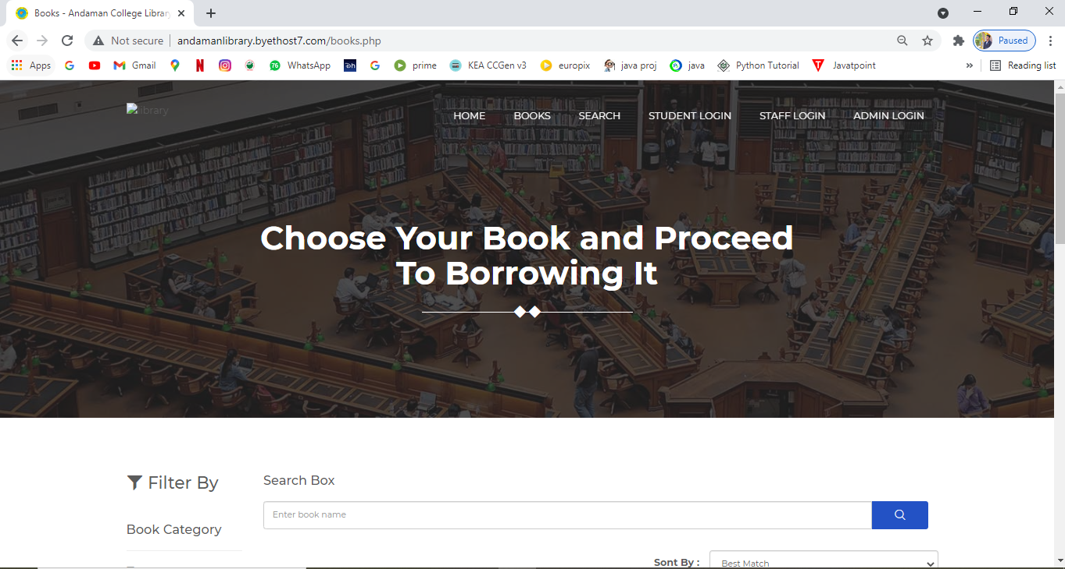
Books Module

Slide 15
Conclusion
This Andaman College Library website provides a computerized version of library management system which will benefit the students as well as the staff of the library. It makes entire process online where student can search books, staff can generate reports and do book transactions. It also has a facility for student login where student can login and can see status of books issued as well request for book or give some suggestions.

Slide 16
THANK YOU

